Slide 1

My Angular Project
Raga Ranjini R
19001198

Slide 2
Drama Fandom
What is the term “Drama” mean ?
Drama is nothing but a web series which mostly consists of 12 – 30 episodes.
It gets telecasted in television like a serial but only twice a week.
Dramas are popular in regions like Korea, Japan and China.
People around other regions can watch these dramas in applications like Rakuten Viki and HiTV.

Slide 3

Introduction
Though there are applications to enable people obsessed with dramas to watch latest dramas. There is no popular platform to recommend entertaining ones according to persons’ preferences.
Taking this itself as a problem statement I have developed this Single Page Application.
Let’s take a look into the application and find out what features I have enhanced .

Slide 4
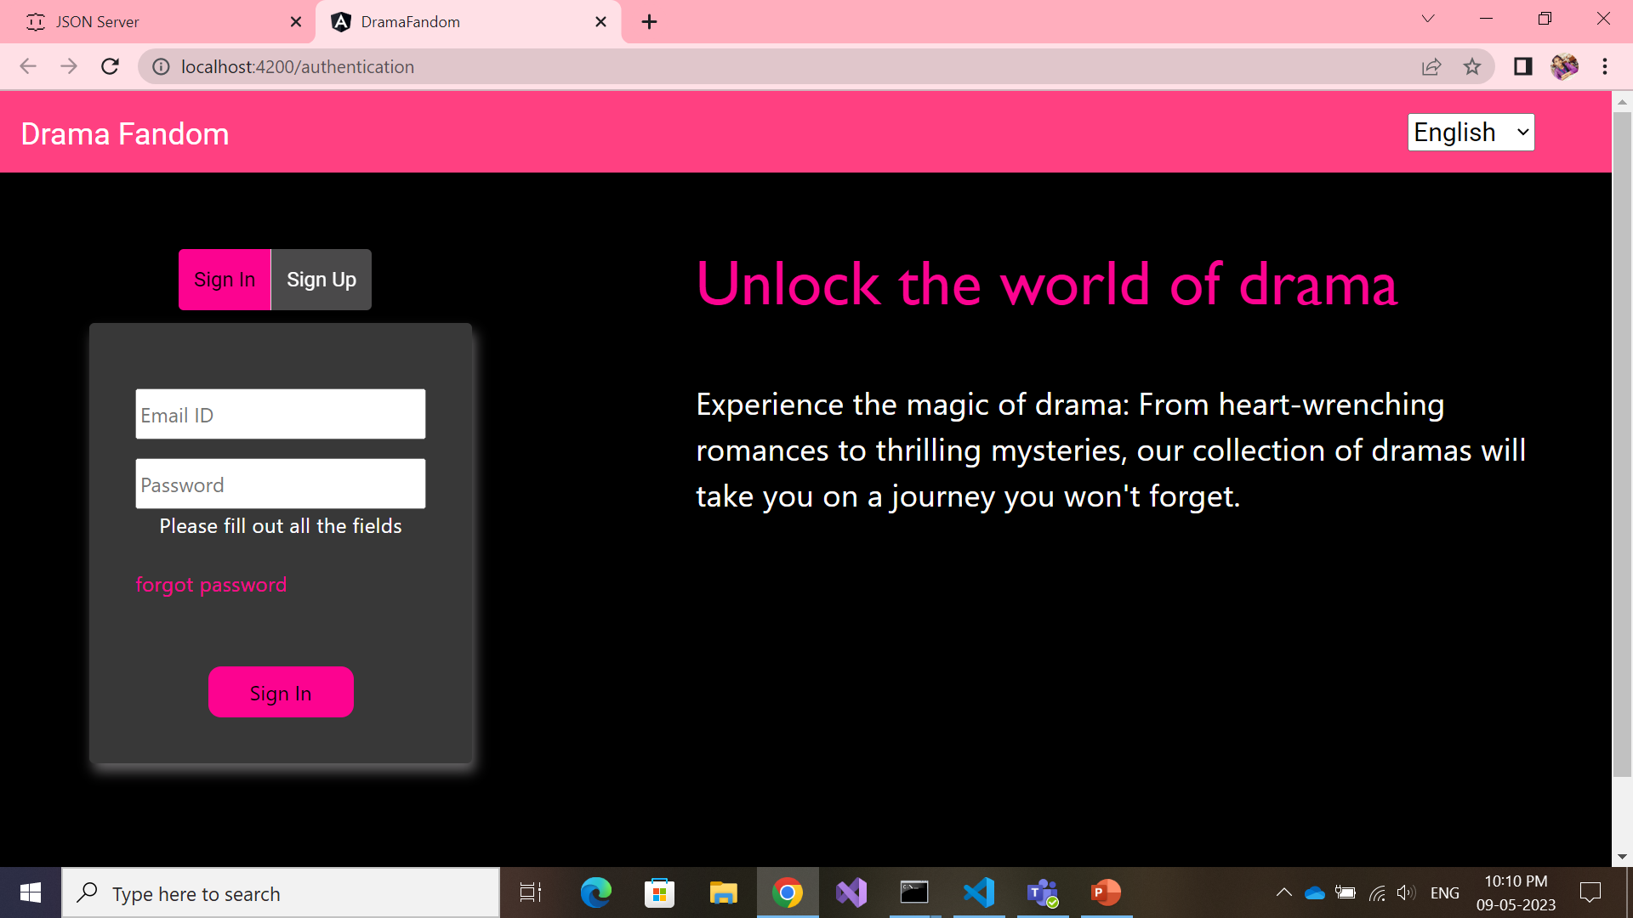
Sign In and Sign Up
Usage:
Material module – toolbar, toggle, card
Sign In – Template based approach
Sign Up – Model based approach
i18n – English, French, Korean, Chinese, Japanese
Lazy loading
Validation
Session storage
Http GET method
Http POST method

Slide 5
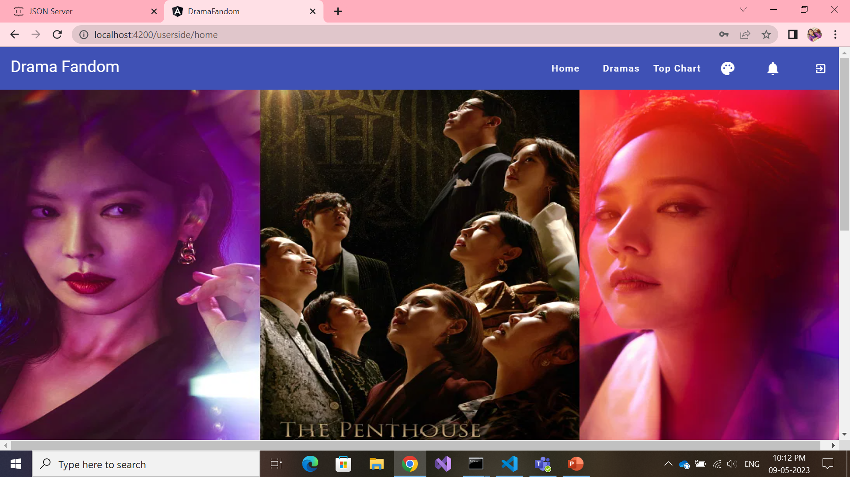
User Home Page
Usage :
Material Module- toolbar, icons, button,menu
Theme Change
Router Navigation
Http GET method

Slide 6
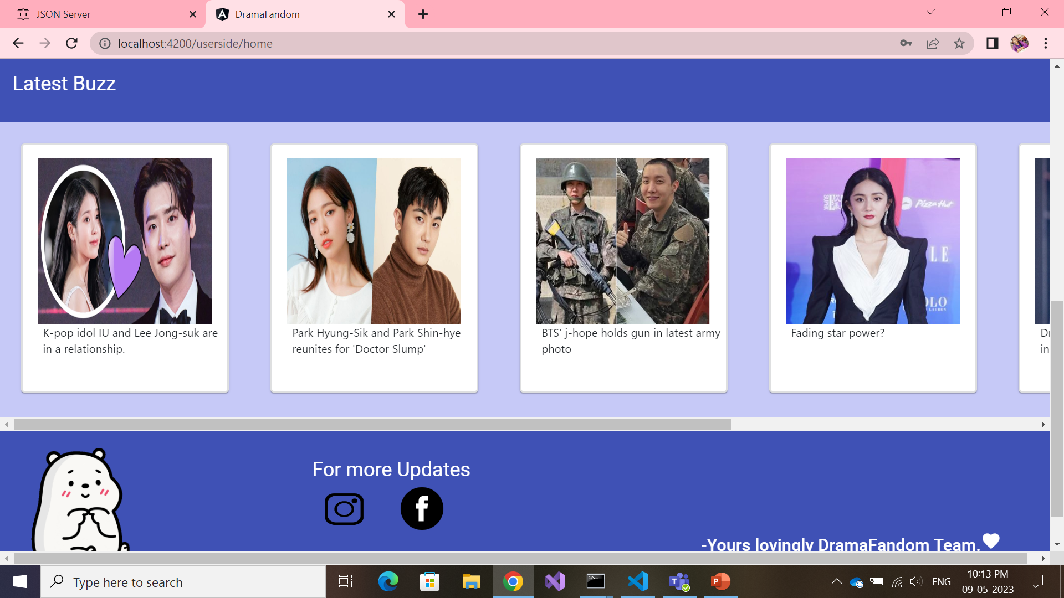
User Home Page
Usage:
Material Module –
Card
Http GET method

Slide 7
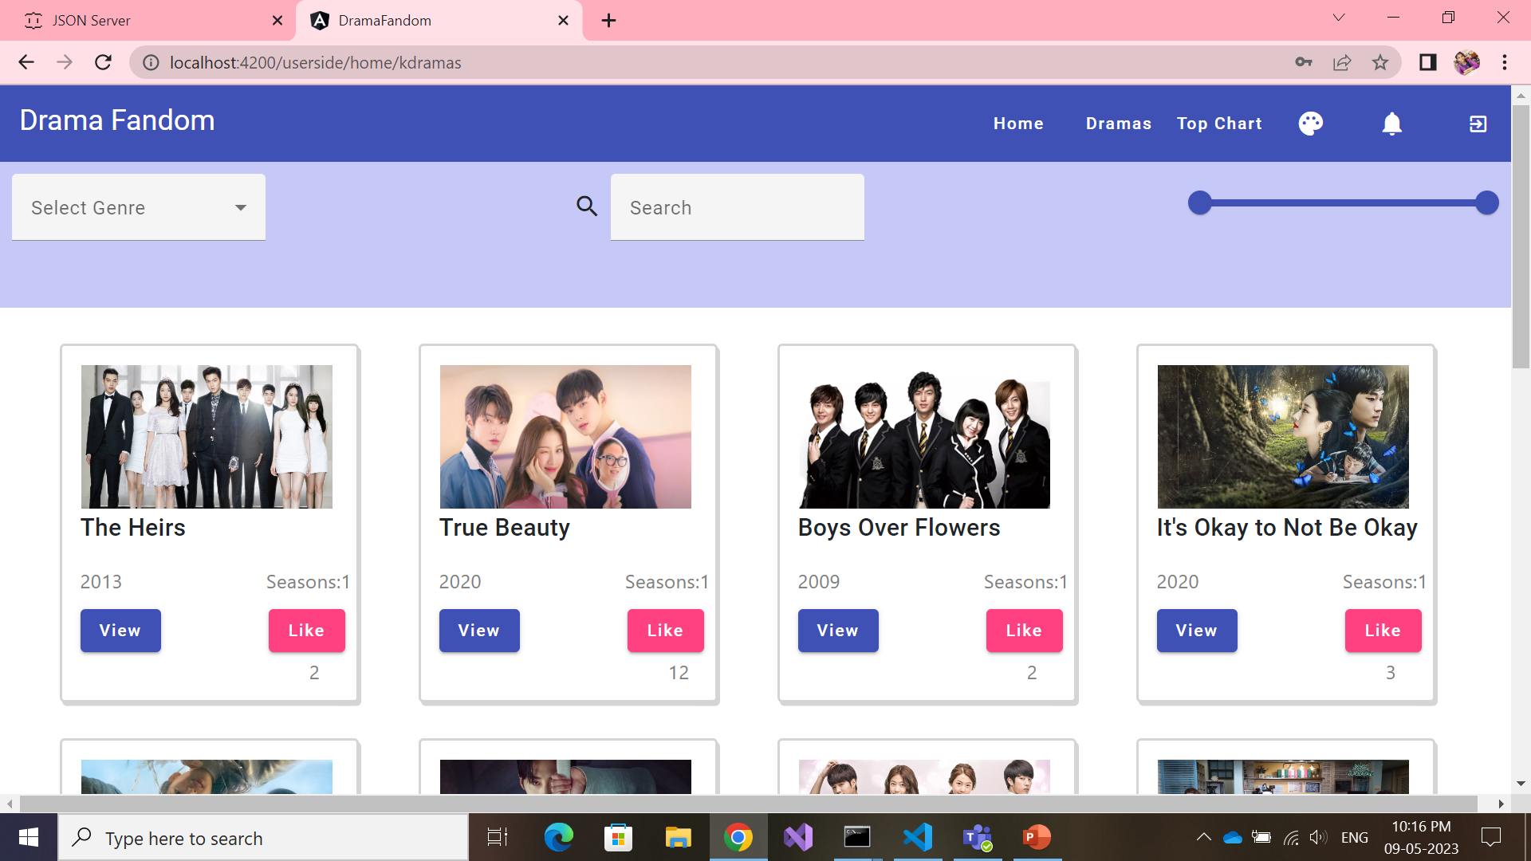
Dramas – Kdramas, Cdramas, Jdramas
Usage :
3 pipes – Language, Releasedyear, SearchBar options
Material module- autocomplete, mat-field, range slider, button
Like Feature –
Http PATCH method
Http GET method

Slide 8
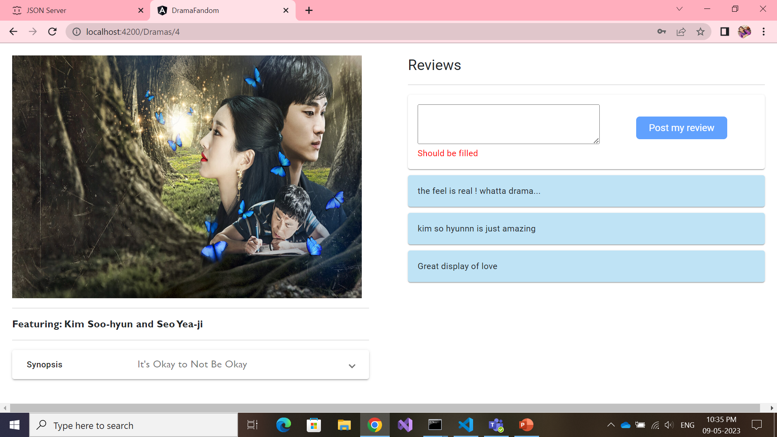
Dramas – View Page
Usage:
Http GET method
Http POST method
Pipe – to filter reviews of that particular (id) drama
Routing parameter

Slide 9
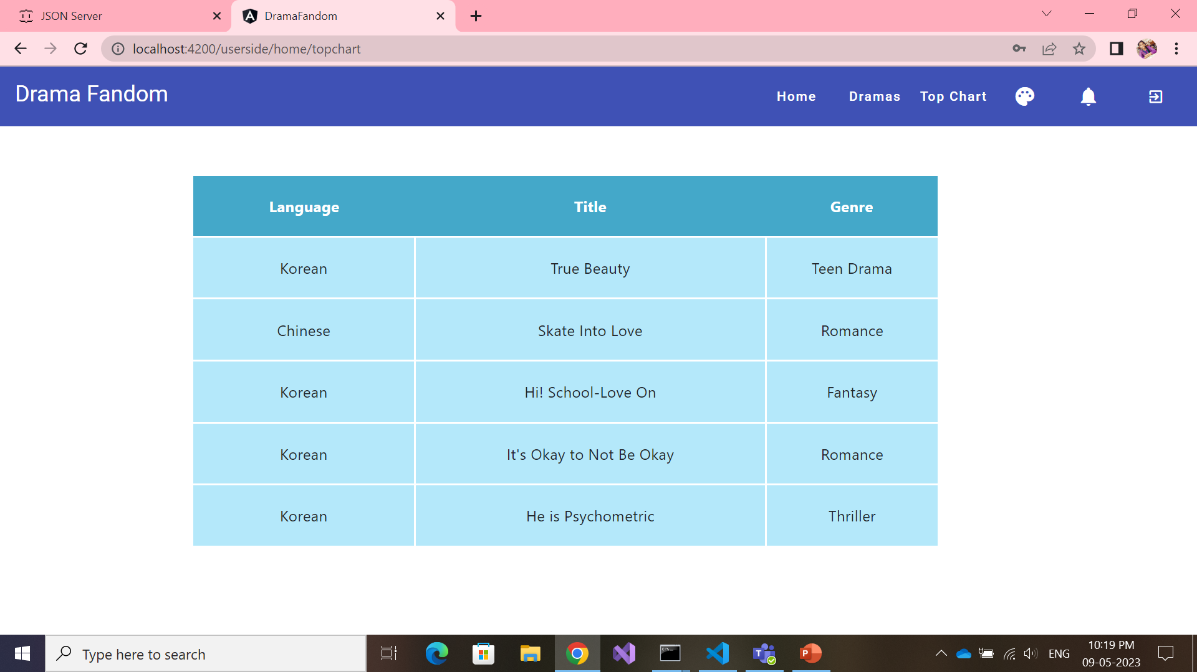
Top Chart
Usage :
Http GET method

Slide 10
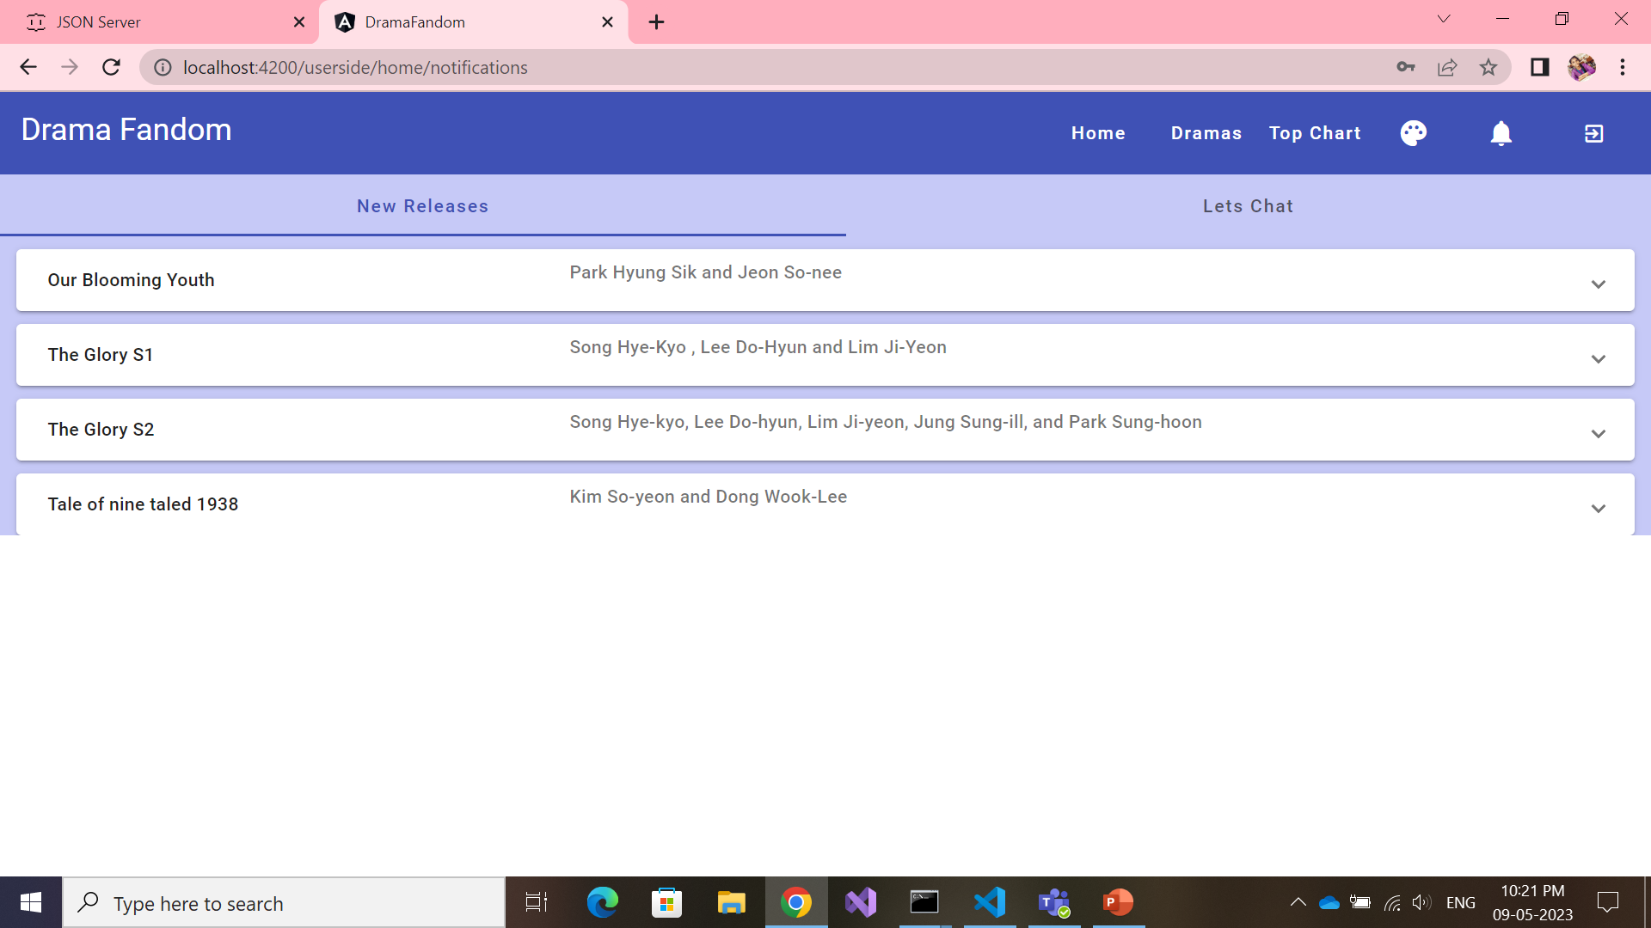
Notifications – Tab1- New Releases
Usage :
Material Module –
Tabs , Expansion panel
Http GET method

Slide 11
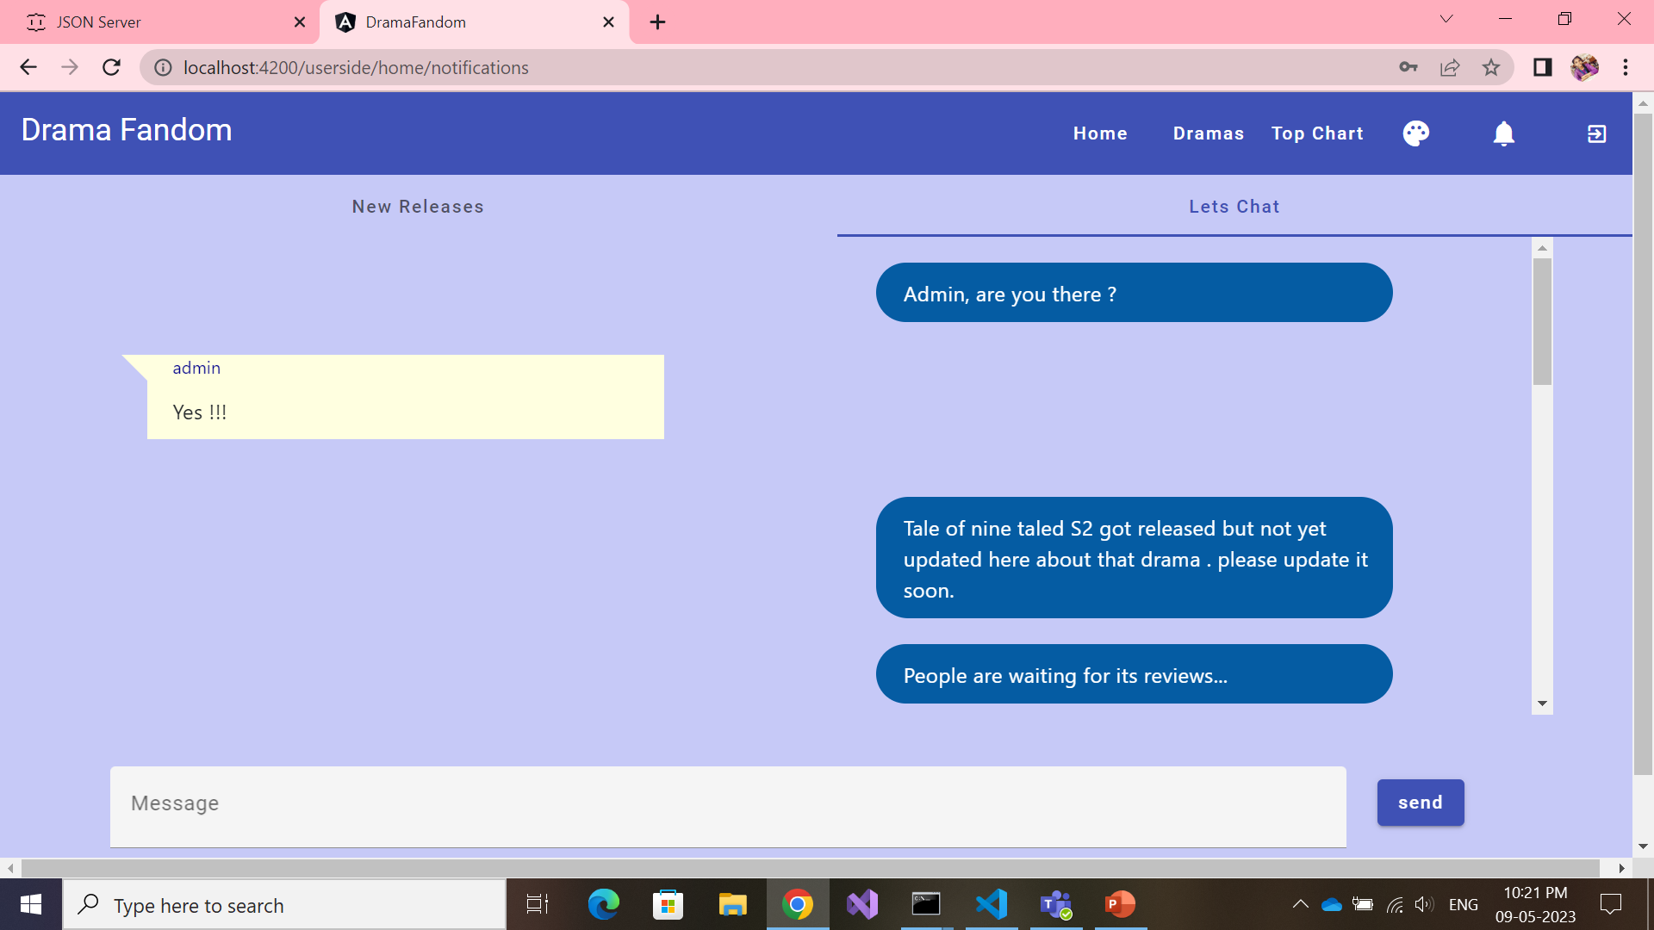
Notifications- Tab2- Chat Bot
Usage :
Http GET method
Http POST method
Material Module – button , field, tabs
Structural Directives : *ngIf , *ngFor

Slide 12
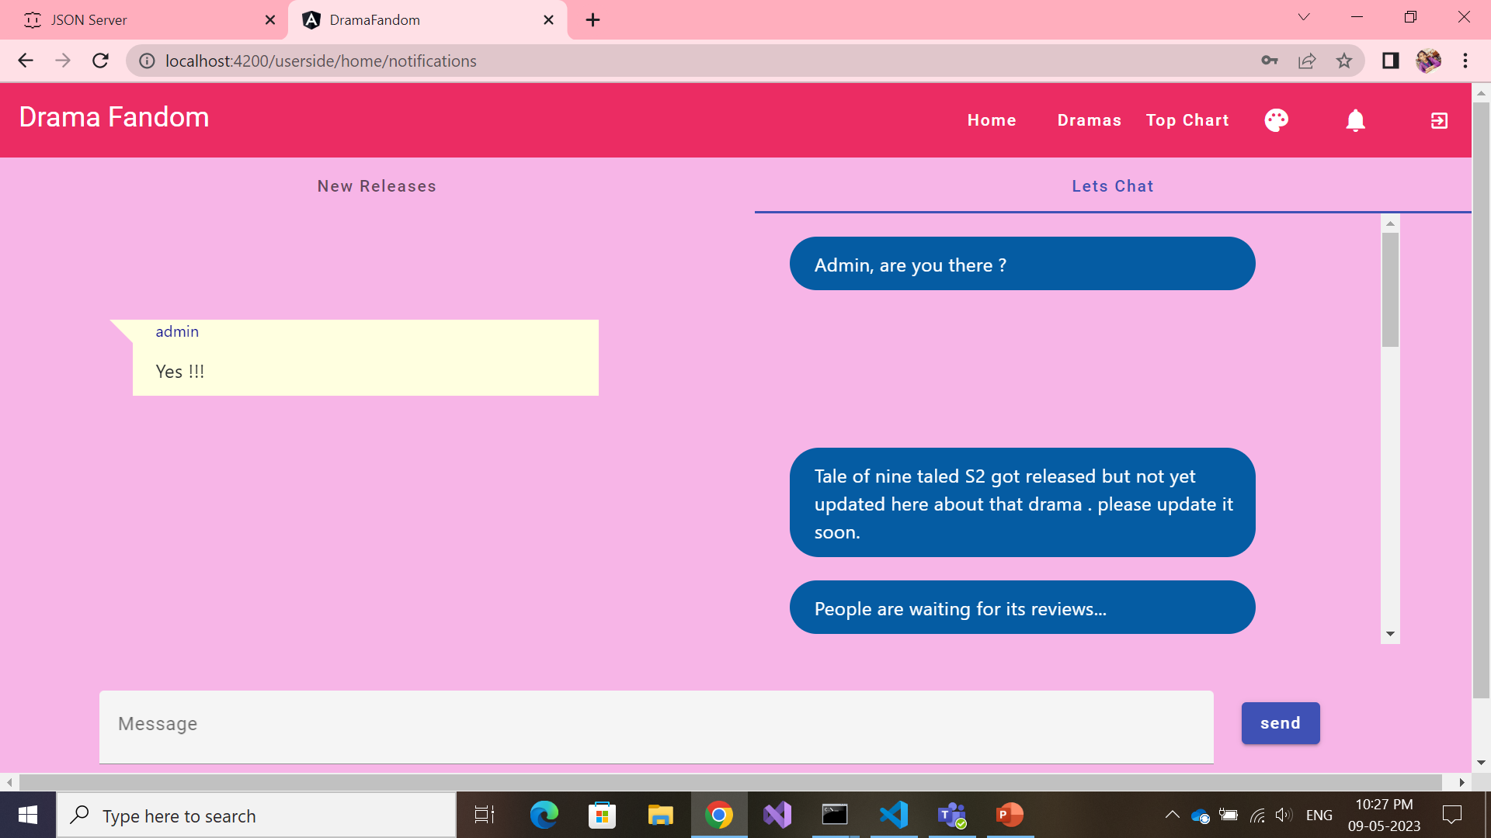
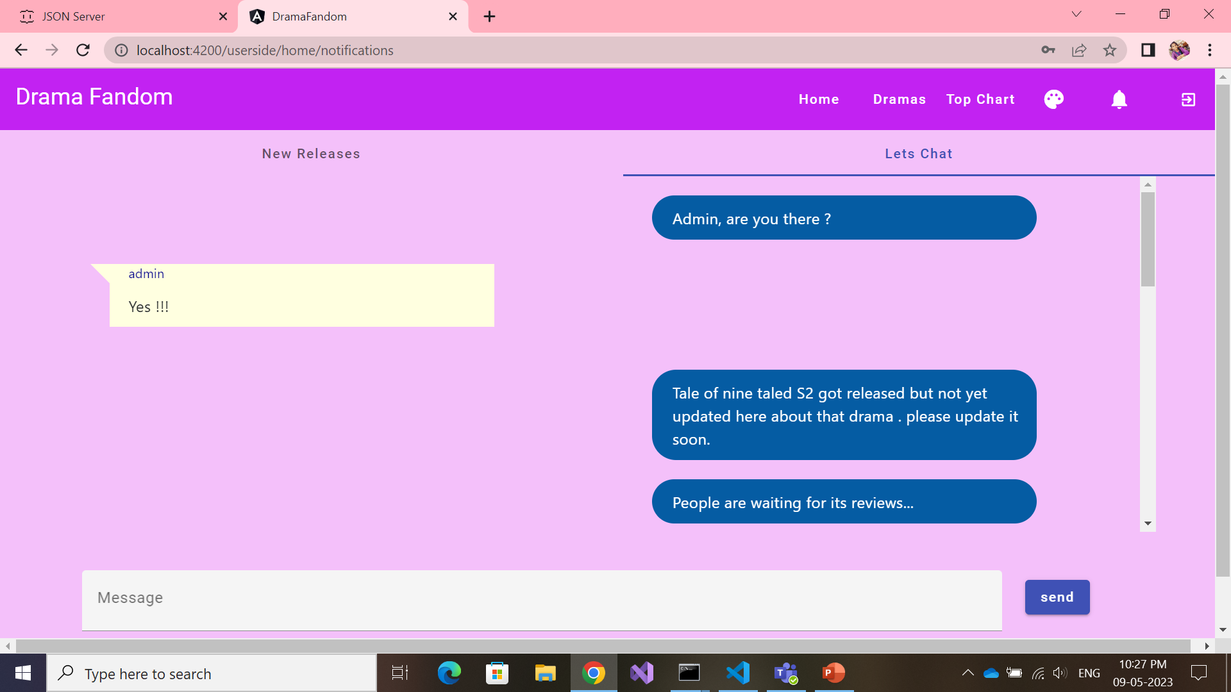
Theme Change
Usage :
Input Directive : [ngStyle]

Slide 13
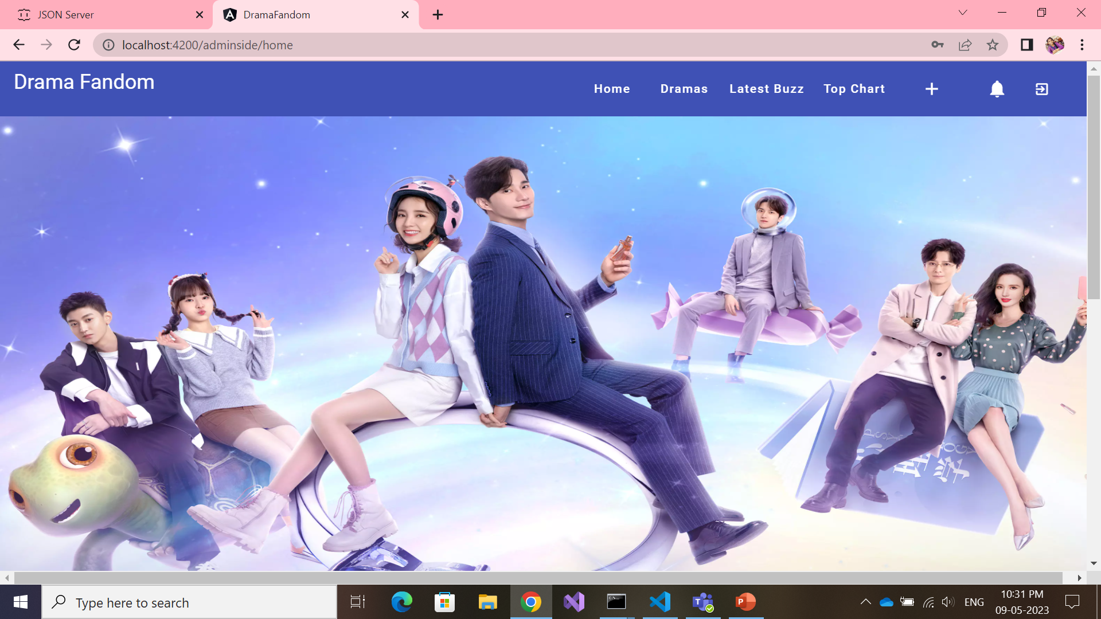
Admin Home Page
Usage :
Material Module- toolbar, icons, button, menu
Router Navigation
Http GET method
Session storage

Slide 14
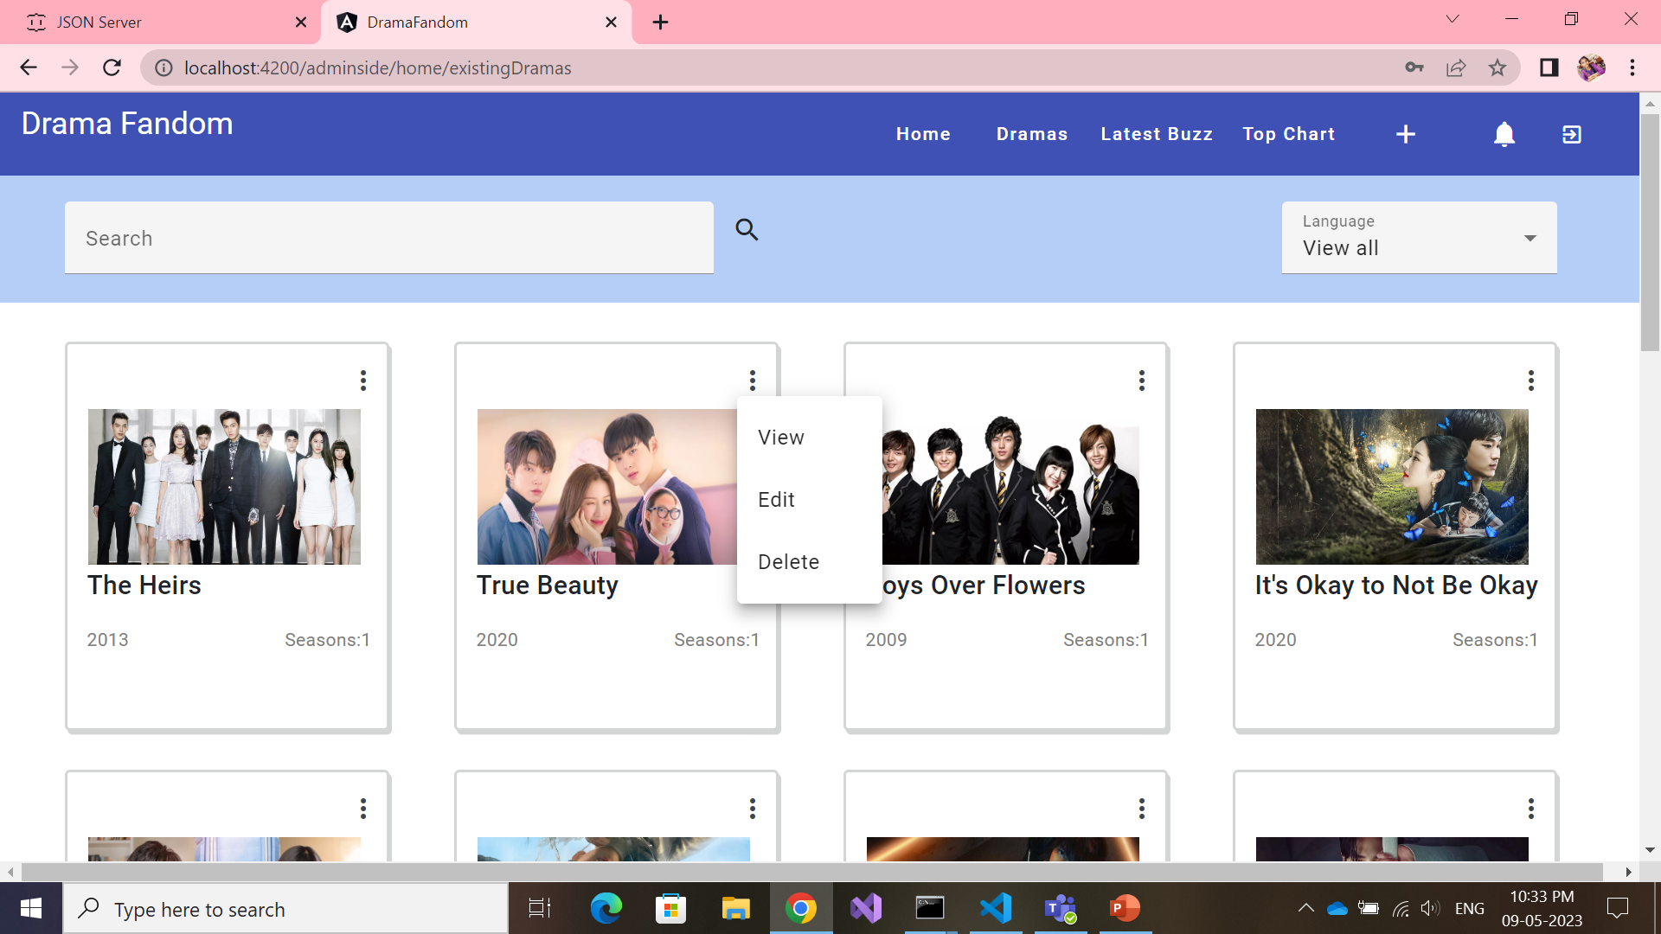
Admin Dramas Page- view,edit,delete
Usage:
Material Module – card, autocomplete, field, icon, menu
2 pipes – searchbar options, language
Http GET method
View – routing parameter
Edit – Http PUT method
Delete – Http DELETE method

Slide 15
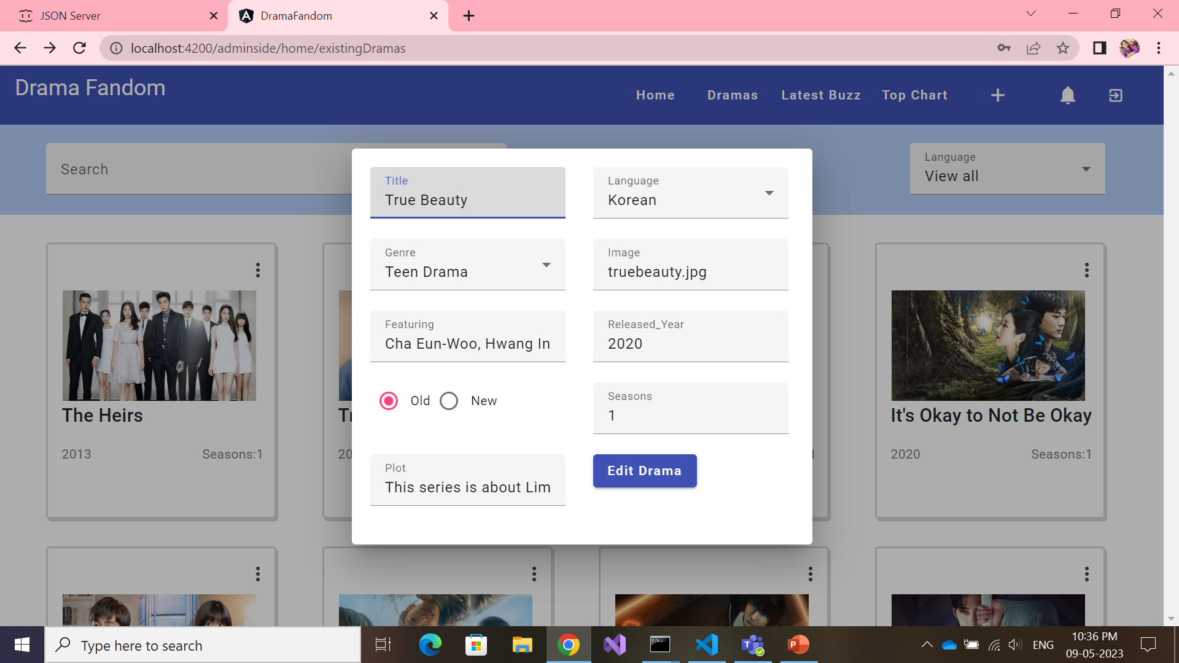
Admin Dramas Page- edit form
Usage :
Material module – Dialog, button, fields, dropdown, radio button
Http GET method
Http PUT method

Slide 16
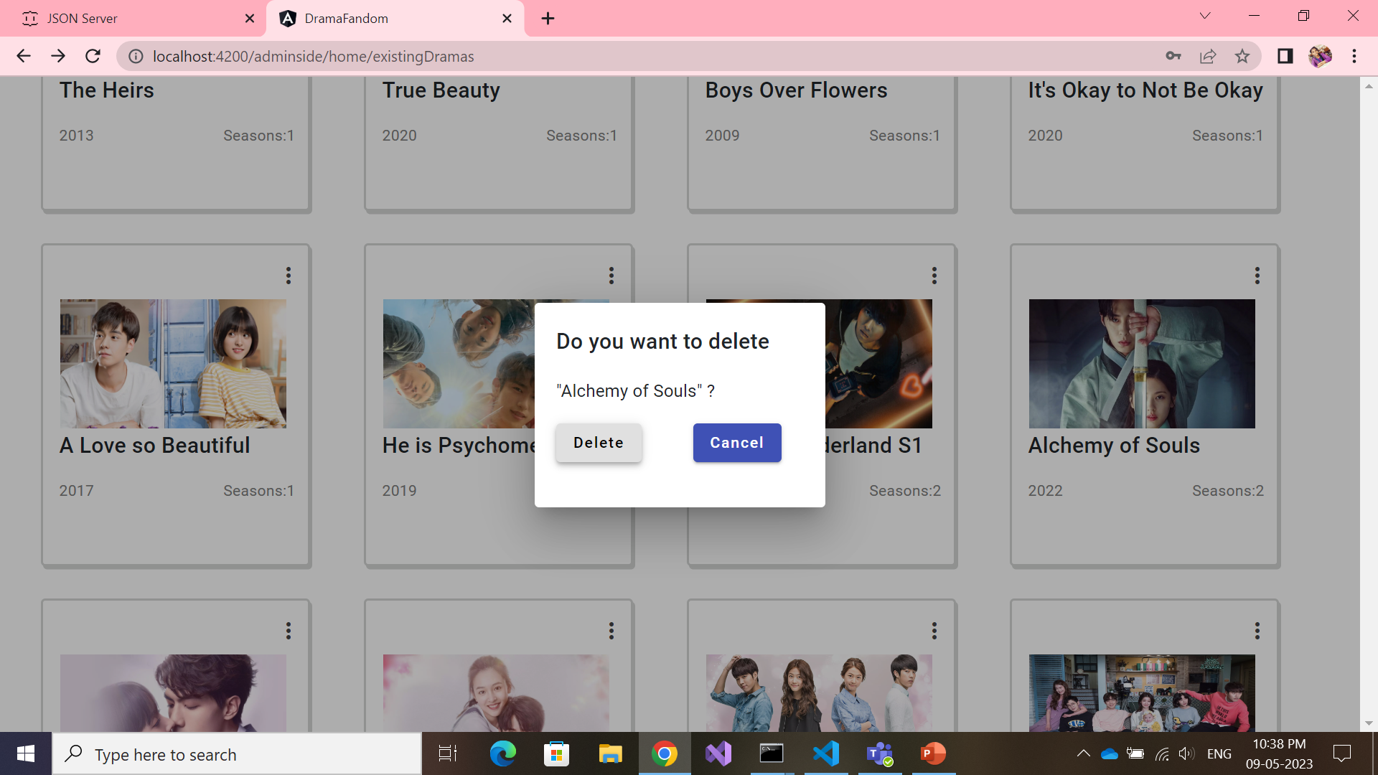
Admin Dramas Page- delete
Usage :
Material module – dialog, button
Http DELETE method

Slide 17
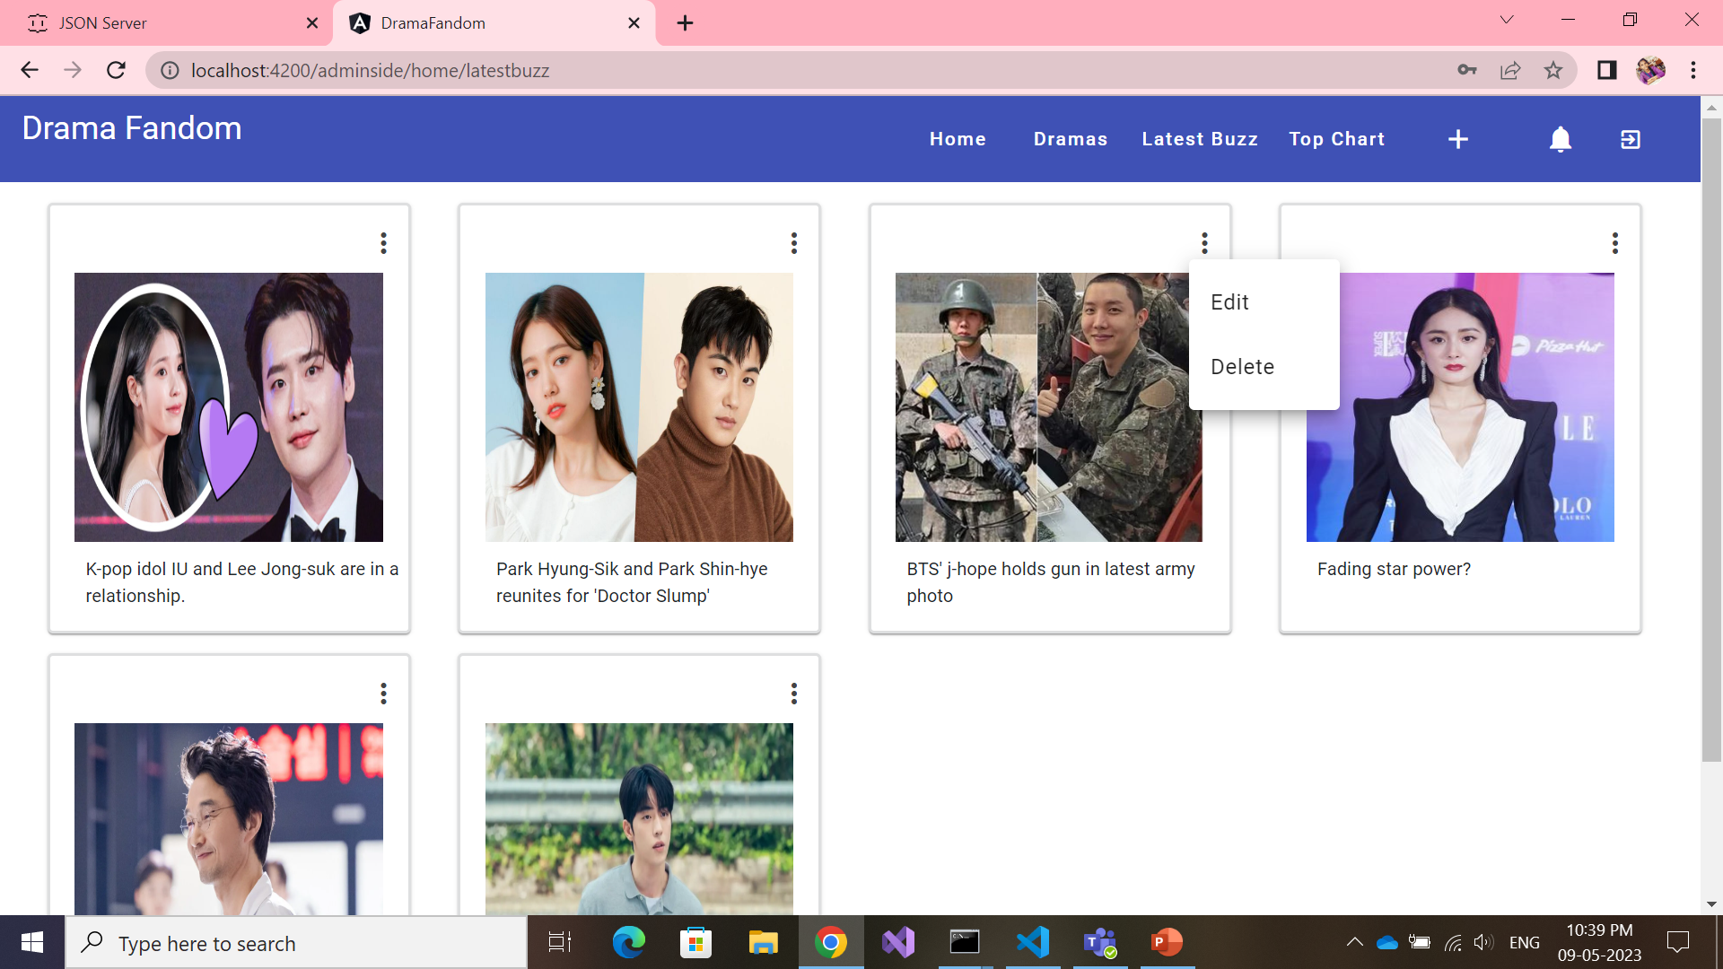
Admin side – Latest Buzz
Usage:
Material module – menu, icons
Http GET method
Http PUT method
Http DELETE method

Slide 18
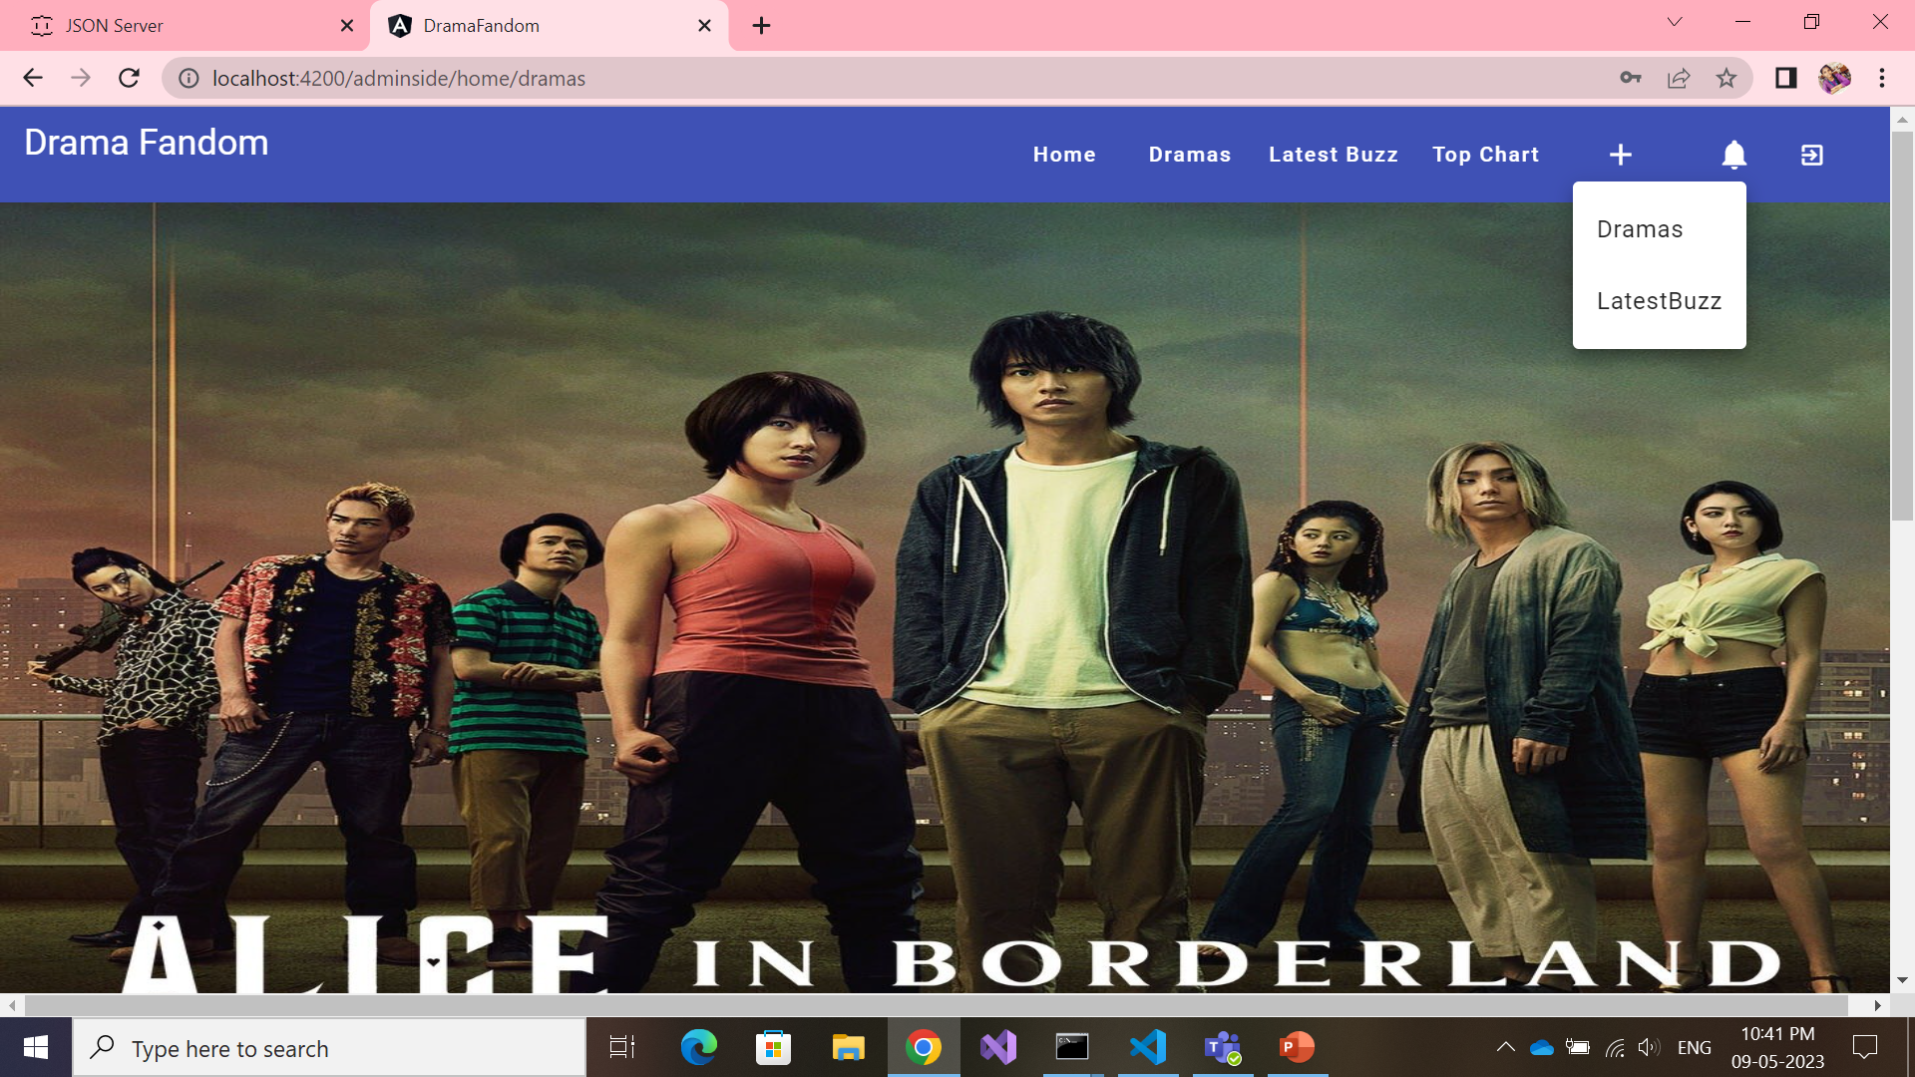
Admin side – Add new Drama/Buzz
Usage :
Material Module – menu, icons
Router Navigation

Slide 19
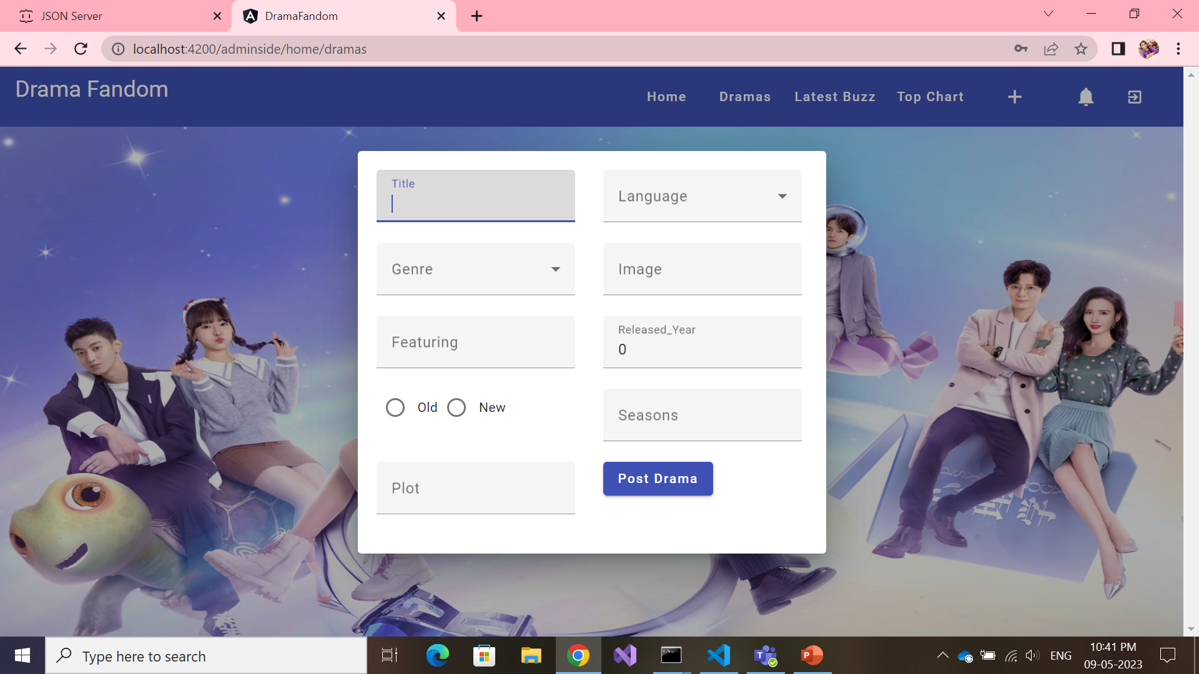
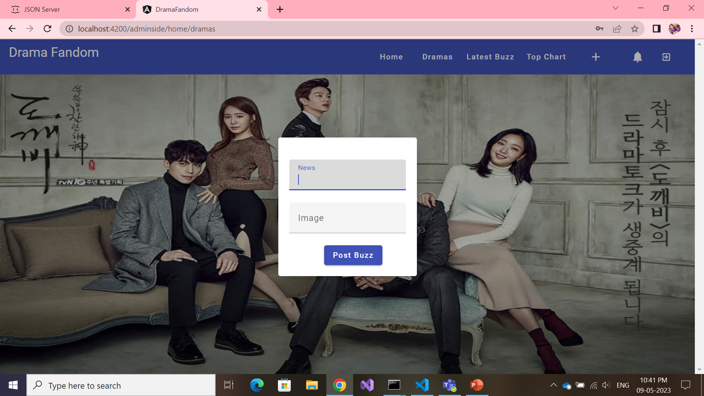
Admin side – Add new Drama/Buzz
Usage :
Material module – dialog, fields, button, dropdown, radio button
Http POST method

Slide 20
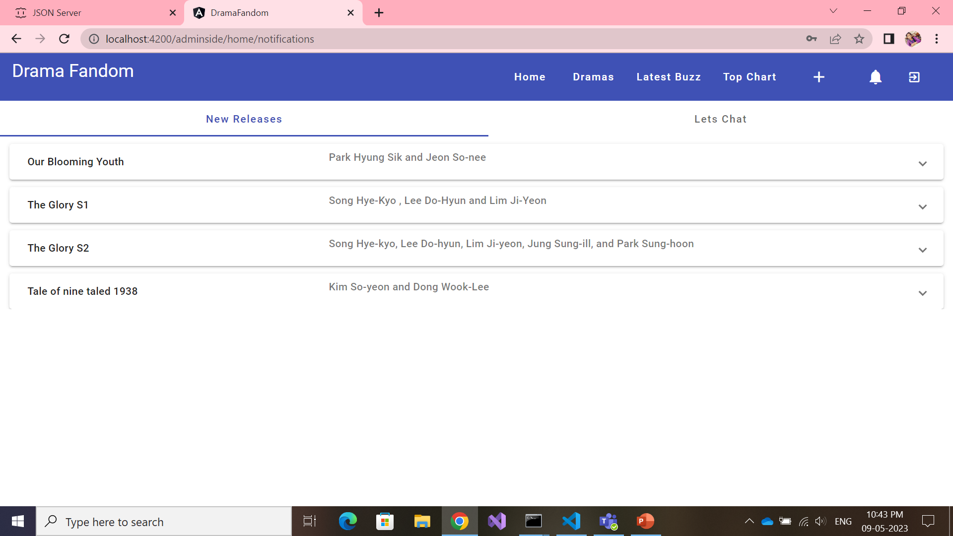
Admin side – Notifications – Tab1
Usage :
Material Module –
Tabs , Expansion panel
Http GET method

Slide 21
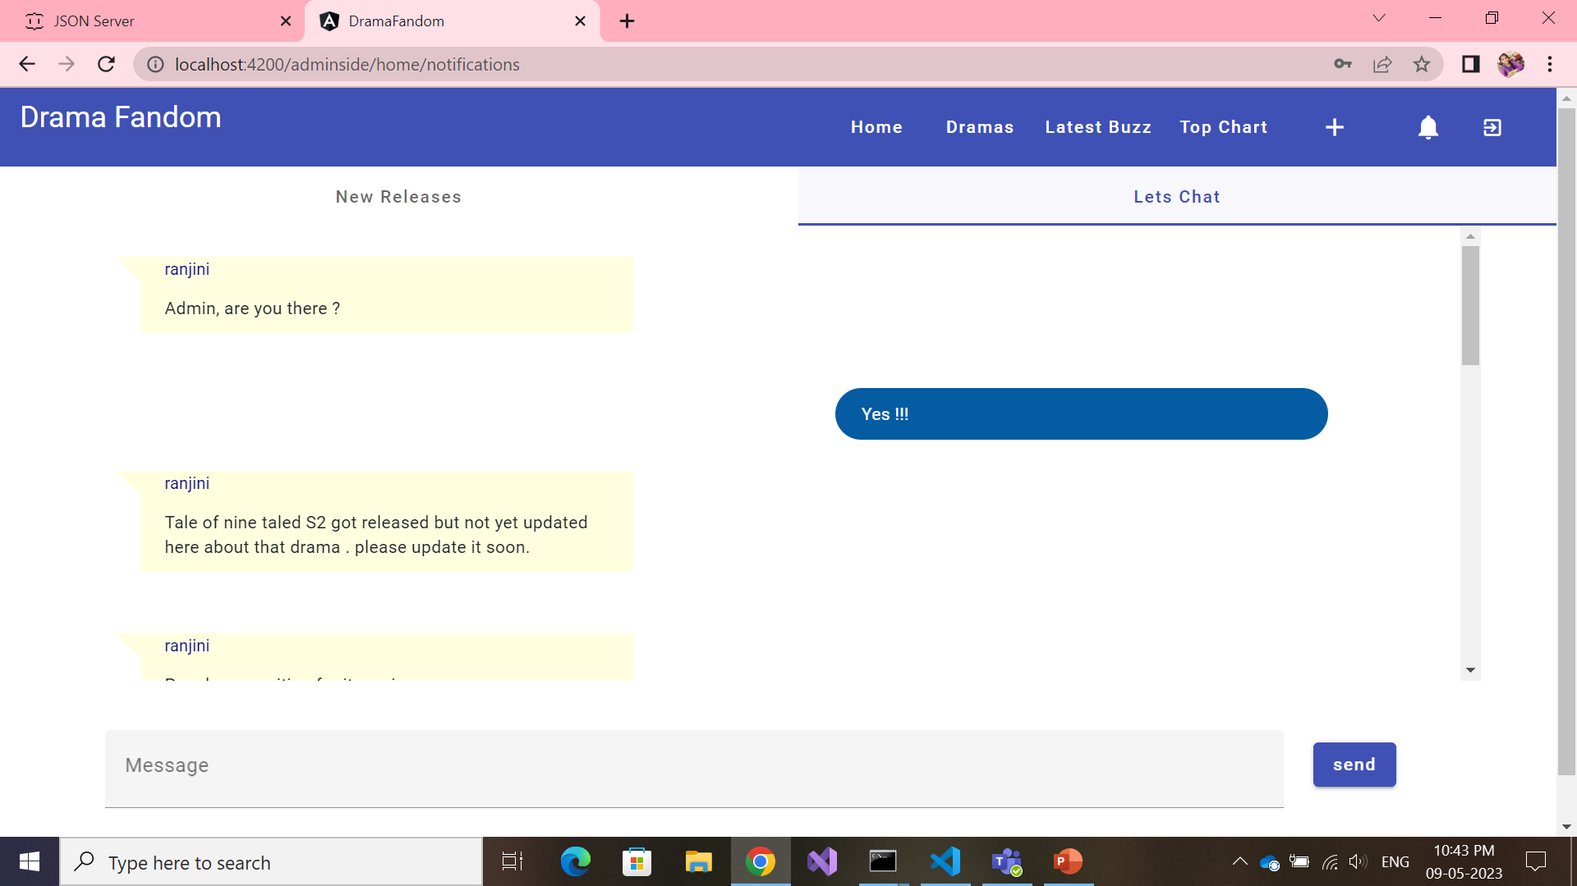
Admin side – Notifications – Tab2
Usage :
Http GET method
Http POST method
Material Module – button , field, tabs
Structural Directives : *ngIf , *ngFor

Slide 22
Concepts not Implemented
Custom Directive
Security Implementation (auth)

Slide 23
Thank you

